Slide 1

Presentation by Chaitalee Patil
CORONA VIRUS ANALYSIS
Data Analysis Project

Slide 2
TO ANALYZE THE IMPACT AND SPREAD OF THE CORONA VIRUS USING SQL DATA ANALYSIS TECHNIQUES.
Province: Geographic subdivision within a country/region.
Country/Region: Geographic entity where data is recorded.
Latitude: North-south position on Earth's surface.
Longitude: East-west position on Earth's surface.
Date: Recorded date of CORONA VIRUS data.
Confirmed: Number of diagnosed CORONA VIRUS cases.
Deaths: Number of CORONA VIRUS related deaths.
Recovered: Number of recovered CORONA VIRUS cases.

Slide 3

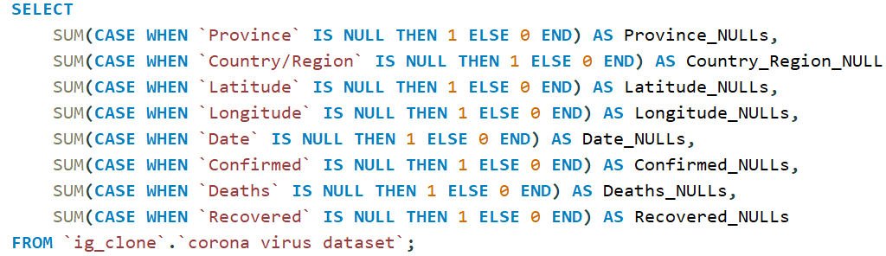
Query to check for NULL values

Slide 4

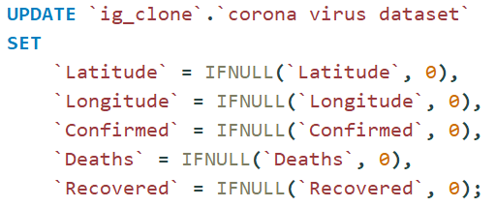
Query to update NULL values to zeros

Slide 5

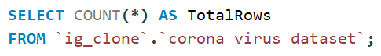
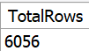
Data Insights
Total Rows

Slide 6

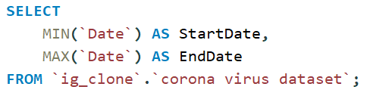
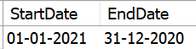
Date Range
start_date and end_date

Slide 7
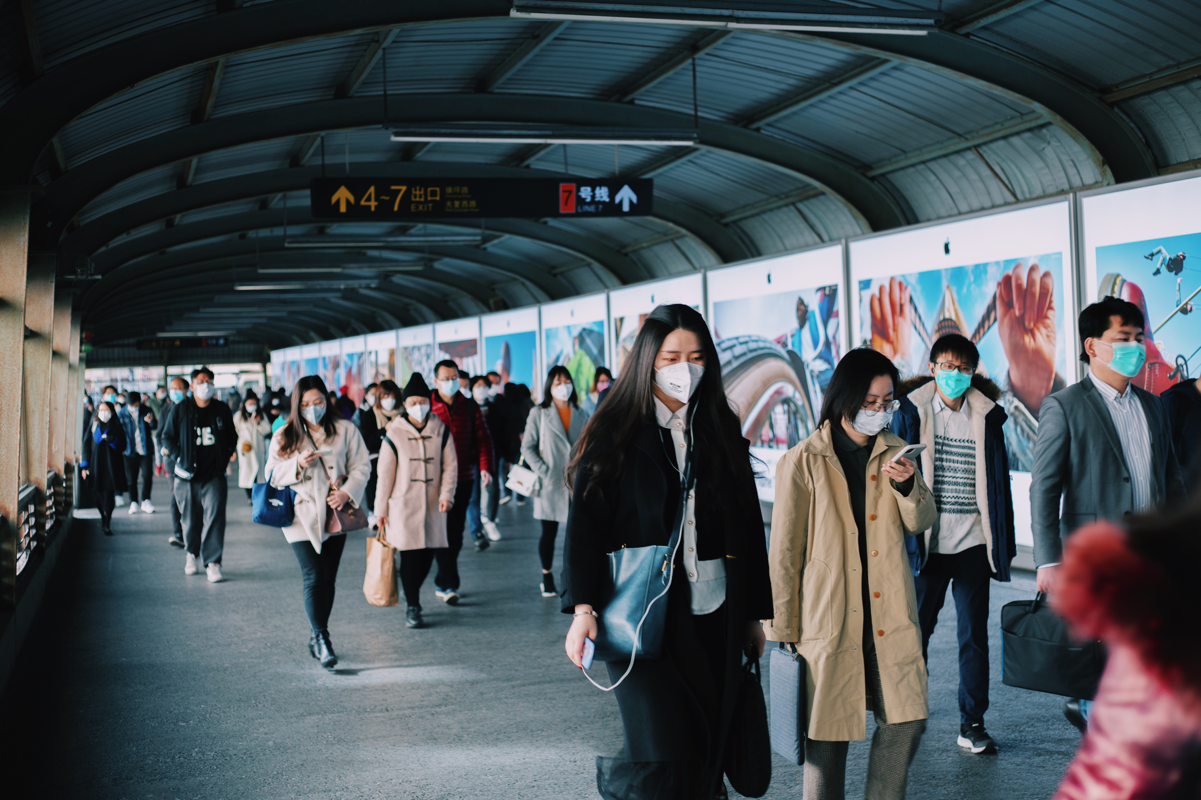
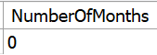
Number of Months in Dataset

Slide 8
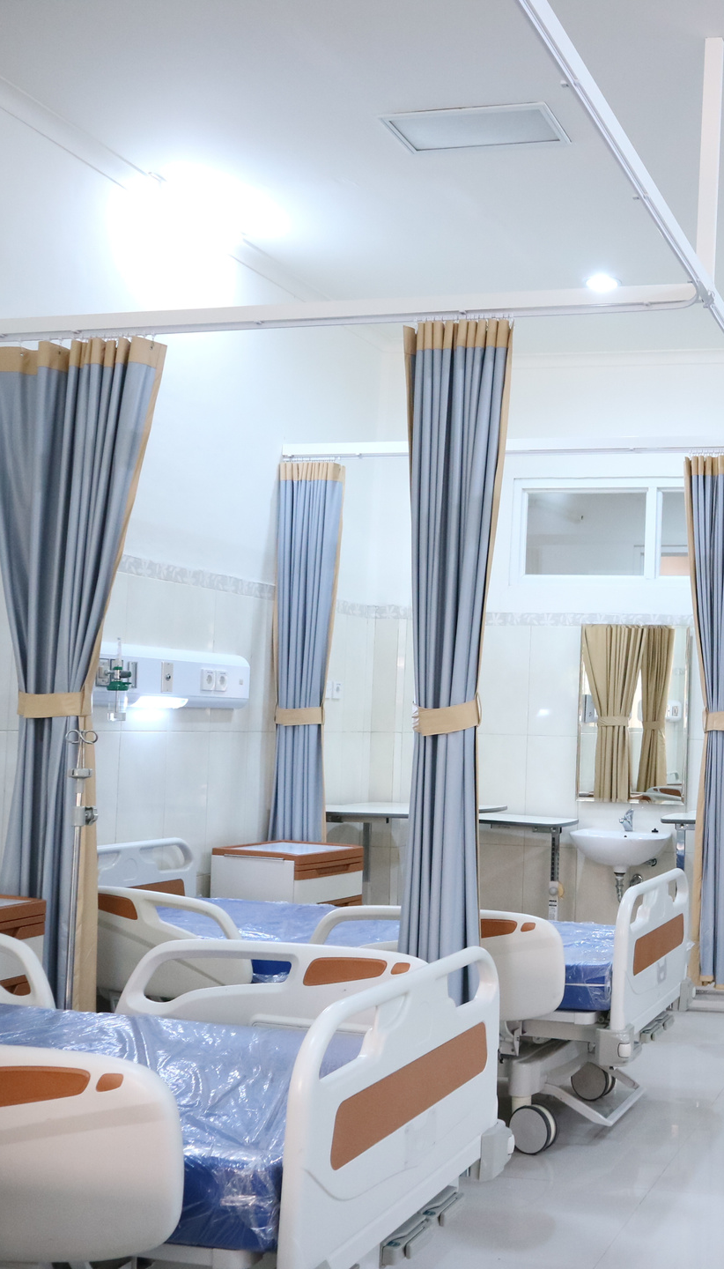
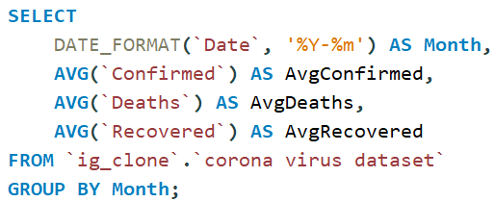
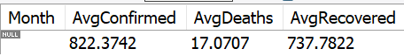
Monthly Analysis
Monthly Averages

Slide 9


Most frequent value for confirmed, deaths, recovered each month
SELECT
Month,
Confirmed,
Deaths,
Recovered
FROM (
SELECT
DATE_FORMAT(`Date`, '%Y-%m') AS Month,
`Confirmed`,
`Deaths`,
`Recovered`,
COUNT(*) AS Frequency,
ROW_NUMBER() OVER (PARTITION BY DATE_FORMAT(`Date`, '%Y-%m') ORDER BY COUNT(*) DESC) AS RowNum
FROM `ig_clone`.`corona virus dataset`
GROUP BY Month, `Confirmed`, `Deaths`, `Recovered`
) AS sub
WHERE RowNum = 1;

Slide 10

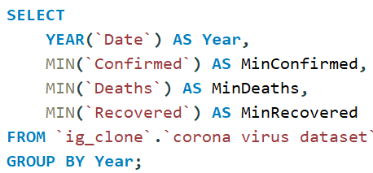
Yearly Analysis
Minimum Values per Year:

Slide 11
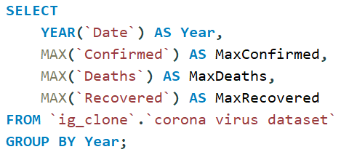
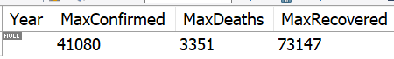
Maximum Values per Year:

Slide 12
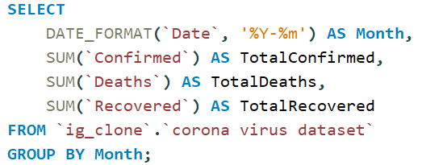
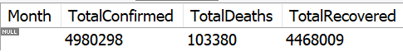
Monthly Totals
Total Cases Each Month:

Slide 13
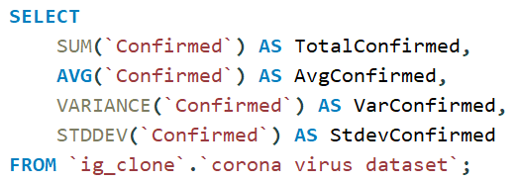
Statistical Analysis
Confirmed Cases Spread:

Slide 14
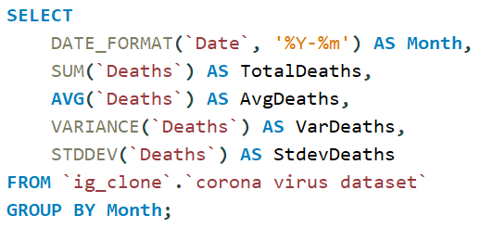
Death Cases Spread (Per Month):

Slide 15
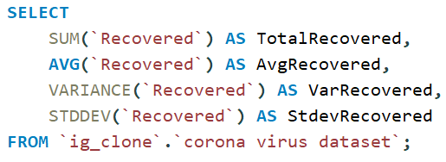
Recovered Cases Spread:

Slide 16
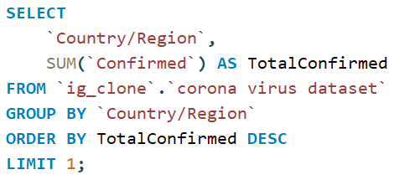
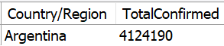
Geographic Insights
Country with Highest Confirmed Cases

Slide 17
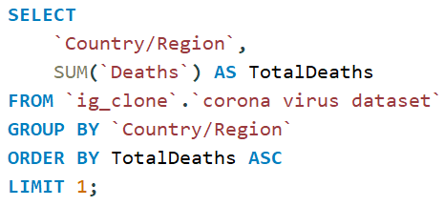
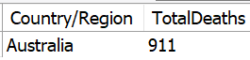
Country with Lowest Death Cases:

Slide 18
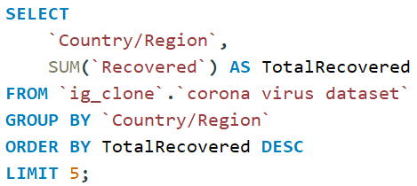
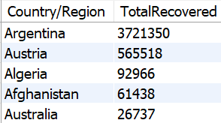
Countries with Highest Recovered Cases:

Slide 19
THANK YOU
Presentation By:
Chaitalee Patil
Third-Year Engineering Student
Project Description:
This data analysis project on the Corona Virus dataset was conducted as part of an internship. The work involved cleaning, analyzing, and deriving insights from the data to understand the spread and impact of the virus.
Acknowledgements:
I would like to thank Mentorness for the opportunity to work on this project and for providing the necessary resources and guidance.

